Slide 1
WebSDM New User Training
[agency Name and Training Date]

Slide 2
Agenda
Introduction and WebSDM Orientation
Navigation Exercise
Break
Completing Assessments and More Navigation
Self-Guided Assessment Completion or Supervisor Tasks
Review and Wrap-Up
Notes:
Example Welcome, everyone. My name is [name], and I work for [agency] as a [job role]. I’m here today to teach you how to use WebSDM. WebSDM is a computer application built specifically to complete Structured Decision Making® ( ) assessments.
Here is the agenda for the day. First, I’ll provide some background information about WebSDM. Then, we’ll log into the training version of WebSDM, go through its features, and complete some assessments as a group using an answer key.

Slide 3
Objectives for Today’s Training
Learn how to complete Structured Decision Making® (SDM) assessments in WebSDM. Focus is on how to complete an assessment, not how to answer an assessment question.
Learn how to find case and referral information from the child welfare services case management system (CWS/CMS) in WebSDM to help complete assessments.
Learn how to manage assessments after completion.
Notes:
Example The focus of this training is not to teach you how to answer assessment items—that critical thinking component was covered during SDM® Common Core training. Our focus is to teach you how to complete assessments in WebSDM and how to use WebSDM to manage past and upcoming assessments.

Slide 4
WebSDM Training Site
Everyone will have the same caseload, based on the case examples from Common Core training.
The training WebSDM site functions almost exactly like your county’s WebSDM.
Notes:
Example
We will use a training site today that includes the same information from the case examples that you used during Common Core training. Once you start completing assessments, you’ll see that the site looks and works just like the training site; but instead of training data, you’ll see your own caseload.

Slide 5
Extract Process
CWS/CMS
Evident Change
WebSDM
Data entered
Data bundled at 7:00 p.m.
Data sent
Data analyzed
WebSDM updated
Case/referral info viewed
Notes:
Example
You may be wondering how WebSDM will know what cases or referrals are on your caseload. WebSDM receives updated data from the child welfare services case management system (CWS/CMS) every night. This is called the data extract. It’s important to understand how this works because the data extract affects when you see new CWS/CMS data in WebSDM.

Slide 6
Example of Extract Timeline
If data entered into CWS/CMS before 7:00 p.m. on Monday:
Available in WebSDM Tuesday morning.
If data entered into CWS/CMS at or after 7:00 p.m. on Monday:
Available in WebSDM Wednesday morning.
Notes:
Example
Every night at around 7:00 p.m., CWS/CMS data is sent to Evident Change to be analyzed and uploaded into WebSDM. If you enter a new referral into CWS/CMS at noon on Monday, you’ll see it on Tuesday. However, if you enter that referral into CWS/CMS at 10:00 p.m. on Monday, you won’t see it until Wednesday.
For those of you who work with referrals, there may be times when you need to start an assessment for a referral that hasn’t made it into WebSDM yet. There are ways of working around this, which we will cover later.
Trainer Note
Minimize the PowerPoint before moving on, but do not close it. Display the next slide before the first group exercise.

Slide 7
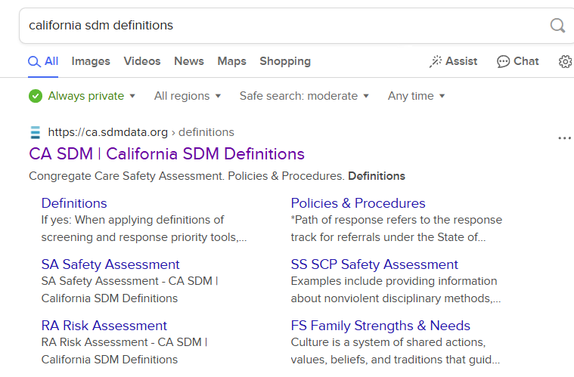
Search on your phone . . .

Slide 8
Logging In
URL: | https://ca-training.sdmdata.org
County: | Select from the drop-down menu
User name: | Assigned at registration
Password: | training

Slide 9
Resources
Site tour
Policy and procedures (P&P) manual and in-application definitions
Document library: User guides, quick references
Tutorials
FAQs
Help desk: support@sdmdata.org

Slide 10
Navigation Exercise
Basic Navigation
My Caseload
To Do List
Assessment Lists

Slide 11
User Panel
Open the P&P link (user panel, book icon) and expand the Reunification link on the left panel.
How many subcategories are available?
Notes:
Trainer Note
Answers:
Nine sub-categories: Policies & Procedures, All Definitions, Reunification Risk, Visitation Plan, Reunification Safety, Decision Trees, Permanency Plan, Recommendation, Sibling

Slide 12
Links Panel
Close the tab. Open the Document Library (links panel). Open the icon legend. What do each of these icons mean?

Notes:
Trainer Note
Answers:
Phone = Referral
Folder = Case
Dots = Assessment action
Pencil = New assessment
Page = Open existing assessment

Slide 13
My Caseload
Close the Document Library and return to My Caseload.
What was the date of Maria Conseco’s referral?
Notes:
Trainer Note
Answer:
Whatever is listed (dates are automatically updated by WebSDM)

Slide 14
My Caseload
How many cases or referrals have an incomplete assessment?
How many have an overdue assessment?
Notes:
Trainer Note
Answers:
None
Five

Slide 15
To Do List
Select View By: Name
Which assessment is due next?
For whose case/referral?
What is the due date?
Notes:
Trainer Note
Answers:
Safety assessment
Tammy Jefferson
Whatever is listed

Slide 16
Assessment Lists
Open Adam’s assessment list and look at the information panel.
What is his case type?
How many relatives also have a case?
Notes:
Trainer Note
Answers:
PP
Three: Ann, Mark, and Nelson

Slide 17
Assessment Lists
Open Adam’s timeline. Filter to Service Component.
When did the most recent service component start?
Notes:
Trainer Note
Answer:
Whatever is listed

Slide 18
Assessment Lists
Return to All Events.
What is the allegation associated with his removal?
Notes:
Trainer Note
Answer:
Physical abuse

Slide 19
Assessment Lists
Look again at Adam’s information panel. Open Nelson’s assessment list.
What was the date of the initiating referral?
Notes:
Trainer Note
Answer:
Whatever is listed

Slide 20
Assessment Lists
Open Ann’s assessment list.
Does she have any overdue assessments?
What was the allegation?
Was it substantiated?
Notes:
Trainer Note
Answers:
Yes: Hotline tools
Physical abuse
Yes

Slide 21
Thank You & Questions
EvidentChange.org (800) 306-6223 Info@EvidentChange.org

